Slide 1
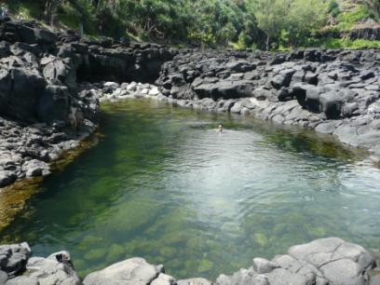
What is Ecotourism?
A commitment to environmental stewardship
A raised awareness of local culture
A travel agenda that reduces threats to wildlife and watershed
A responsible approach to minimizing the impact of tourism

Slide 2
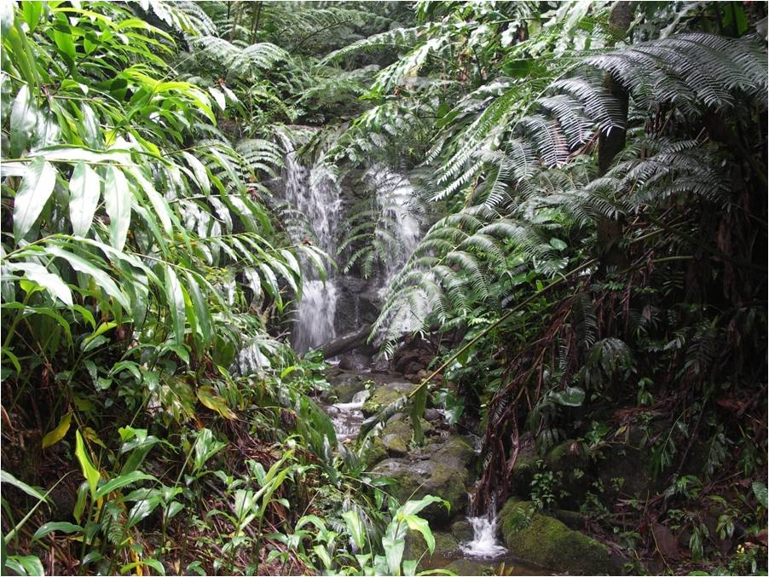
Eco Tours Division
Lehua Adventure Tours

Slide 3
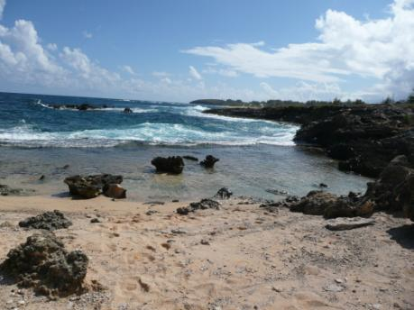
Spiritual Sea Cleanse
Explore a purifying wash of the sea at a small hidden beach
Offered Tuesdays and Thursdays one hour before sunset, weather permitting
Fee: $30

Slide 4
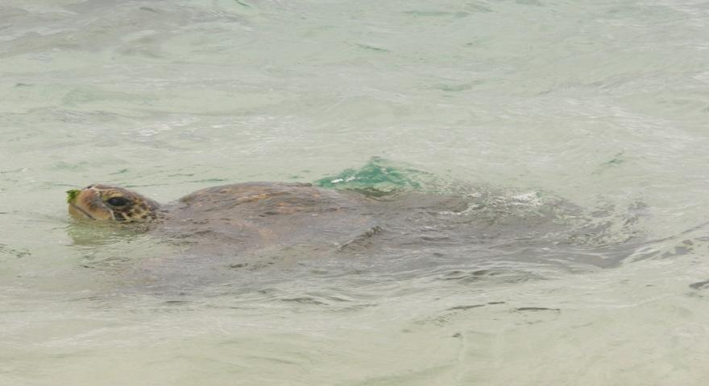
Snorkeling with Sea Turtles
Explore the underwater beauty of the islands without disturbing this protected sea creature

Slide 5
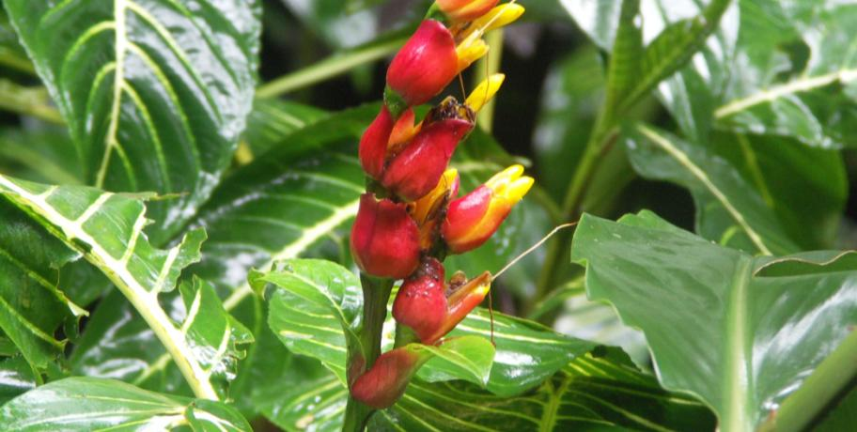
Native Hawaii
Explore ancient and endangered plant species on this special one-mile hike through densely forested vegetation. Wednesdays from 1:00 to 5:00 p.m.

Slide 6
Lehua Eco Day Tours
A member of the Hawaii Ecotourism Association and 2010 winner for the HEA Ecotour of the Year

